Slide 1

Network security
Public key cryptography - Hashes
Notes:
Lecture slides by Lawrie Brown for “Cryptography and Network Security”, 5/e, by William Stallings, Chapter 10 – “Other Public Key Cryptosystems”.

Slide 2
Cryptographic hash functions

Slide 3
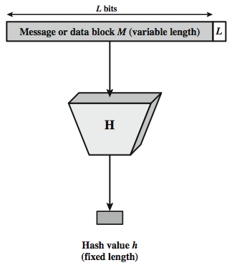
Cryptographic Hash Function
Notes:
Stallings Figure 11.1 depicts the general operation of a cryptographic hash function. Typically, the input is padded out to an integer multiple of some fixed length (e.g., 1024 bits) and the padding includes the value of the length of the original message in bits. The length field is a security measure to increase the difficulty for an attacker to produce an alternative message with the same hash value.

Slide 4
Cryptographic Hash Functions
condenses arbitrary message to fixed size
h = H(M)
usually assume hash algorithm is public
hash used to detect changes to message
want a cryptographic hash function
computationally infeasible to find data mapping to specific hash (one-way property)
computationally infeasible to find two data to same hash (collision-free property)
Notes:
A hash function H accepts a variable-length block of data M as input and produces a fixed-size hash value h = H(M). A "good" hash function has the property that the results of applying the function to a large set of inputs will produce outputs that are evenly distributed, and apparently random. In general terms, the principal object of a hash function is data integrity. A change to any bit or bits in M results, with high probability, in a change to the hash code. The kind of hash function needed for security applications is referred to as a cryptographic hash function. A cryptographic hash function is an algorithm for which it is computationally infeasible (because no attack is significantly more efficient than brute force) to find either (a) a data object that maps to a pre-specified hash result (the one-way property) or (b) two data objects that map to the same hash result (the collision-free property). Because of these characteristics, hash functions are often used to determine whether or not data has changed.

Slide 5
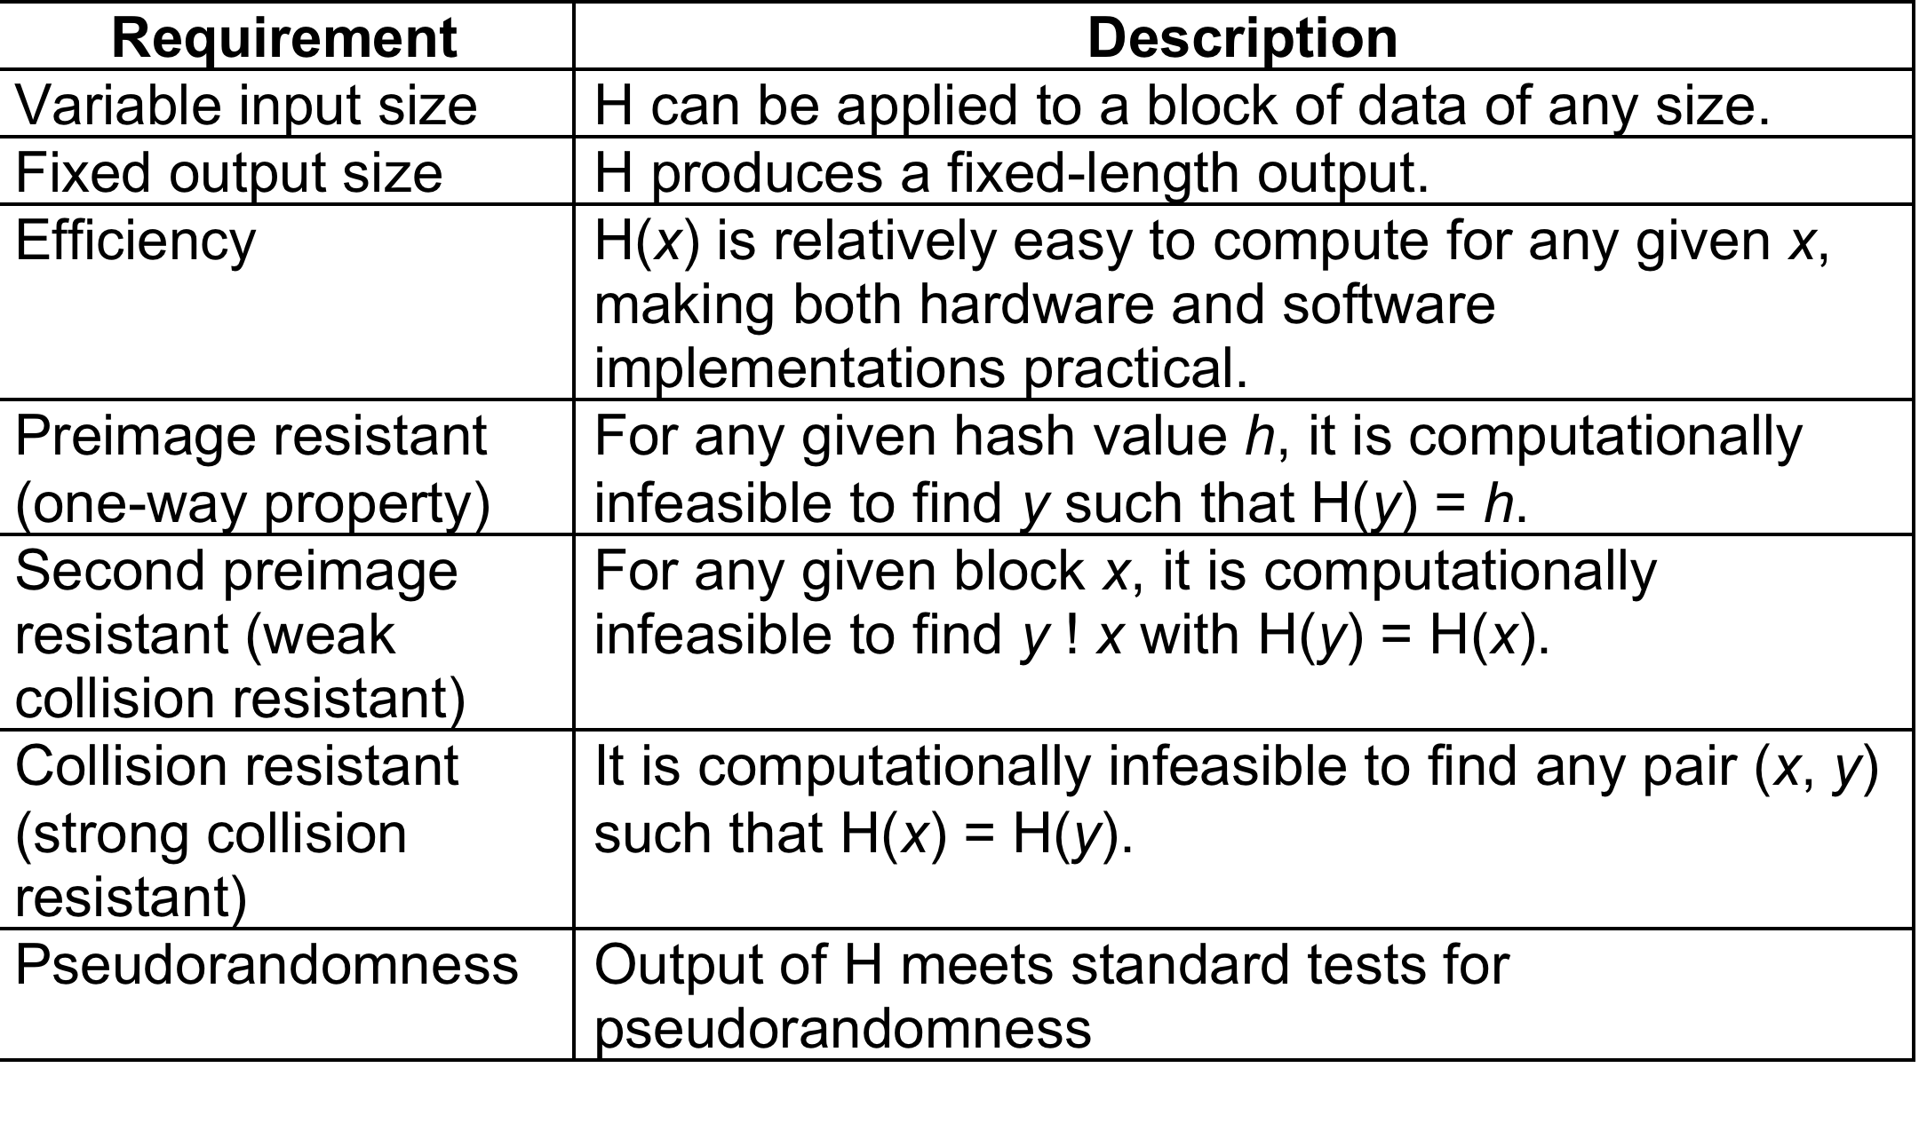
Hash Function Requirements
Notes:
Stallings Table 11.1 lists the generally accepted requirements for a cryptographic hash function. The first three properties are requirements for the practical application of a hash function. The fourth property, preimage (for a hash value h = H(x), we say that x is the preimage of h) resistant, is the one-way property: it is easy to generate a code given a message, but virtually impossible to generate a message given a code. This property is important if the authentication technique involves the use of a secret value (Figure 11.2c). The fifth property, second preimage resistant, guarantees that it is impossible to find an alternative message with the same hash value as a given message. This prevents forgery when an encrypted hash code is used (Figure 11.2b and Figure 11.3a). A hash function that satisfies the first five properties in Table 11.1 is referred to as a weak hash function. If the sixth property, collision resistant, is also satisfied, then it is referred to as a strong hash function. A strong hash function protects against an attack in which one party generates a message for another party to sign. The final requirement, pseudorandomness, has not traditionally been listed as a requirement of cryptographic hash functions, but is more or less implied.

Slide 6
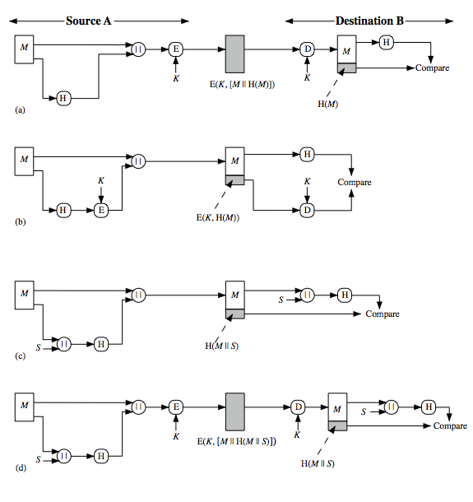
Hash Functions & Message Authent-ication
Notes:
Message authentication is a mechanism or service used to verify the integrity of a message, by assuring that the data received are exactly as sent. Stallings Figure 11.2 illustrates a variety of ways in which a hash code can be used to provide message authentication, as follows:
The message plus concatenated hash code is encrypted using symmetric encryption. Since only A and B share the secret key, the message must have come from A and has not been altered. The hash code provides the structure or redundancy required to achieve authentication.
Only the hash code is encrypted, using symmetric encryption. This reduces the processing burden for those applications not requiring confidentiality.
Shows the use of a hash function but no encryption for message authentication. The technique assumes that the two communicating parties share a common secret value S. A computes the hash value over the concatenation of M and S and appends the resulting hash value to M. Because B possesses S, it can recompute the hash value to verify. Because the secret value itself is not sent, an opponent cannot modify an intercepted message and cannot generate a false message.
Confidentiality can be added to the approach of (c) by encrypting the entire message plus the hash code.
When confidentiality is not required, method (b) has an advantage over methods (a) and (d), which encrypts the entire message, in that less computation is required.

Slide 7
Other Hash Function Uses
Commonly used to create a one-way password file
When a user enters a password, the hash of that password is compared to the stored hash value for verification
This approach to password protection is used by most operating systems
Can be used for intrusion and virus detection
Store H(F) for each file on a system and secure the hash values
One can later determine if a file has been modified by recomputing H(F)
An intruder would need to change F without changing H(F)
Can be used to construct a pseudorandom function (PRF) or a pseudorandom number generator (PRNG)
A common application for a hash-based PRF is for the generation of symmetric keys
Digital currency proof of work
Sign transaction blocks by bruteforcing hash values with a fixed number of ‘0’s
Notes:
Hash functions are commonly used to create a one-way password file. Chapter 24 explains a scheme in which a hash of a password is stored by an operating system rather than the password itself. Thus, the actual password is not retrievable by a hacker who gains access to the password file. In simple terms, when a user enters a password, the hash of that password is compared to the stored hash value for verification. This approach to password protection is used by most operating systems.
Hash functions can be used for intrusion detection and virus detection. Store H(F) for each file on a system and secure the hash values (e.g., on a CD-R that is kept secure). One can later determine if a file has been modified by recomputing H(F). An intruder would need to change F without changing H(F).
A cryptographic hash function can be used to construct a pseudorandom function (PRF) or a pseudorandom number generator (PRNG). A common application for a hash-based PRF is for the generation of symmetric keys. We discuss this application in Chapter 12.

Slide 8
Notes:
Figure 11.6 shows the relationships among the three resistant properties.
A function that is collision resistant is also second preimage resistant, but the
reverse is not necessarily true. A function can be collision resistant but not preimage
resistant and vice versa. A function can be preimage resistant but not second
preimage resistant and vice versa. See [MENE97] for a discussion.

Slide 9
Table 11.2 Hash Function Resistance Properties Required for Various Data Integrity Applications
* Resistance required if attacker is able to mount a chosen message attack
Notes:
Table 11.2 shows the resistant properties required for various hash function
applications.

Slide 10
Common hash functions
MD5 (can find collisions easily nowadays)
SHA1 (same as above)
SHA2: SHA-256, SHA-512
SHA3
RIPEMD-160 (Bitcoin uses this)
Whirlpool (loosely based on AES)
GOST

Slide 11
Attacks on Hash Functions
Brute-Force Attacks
Cryptanalysis
Does not depend on the specific algorithm, only depends on bit length
In the case of a hash function, attack depends only on the bit length of the hash value
Method is to pick values at random and try each one until a collision occurs
An attack based on weaknesses in a particular cryptographic algorithm
Seek to exploit some property of the algorithm to perform some attack other than an exhaustive search
Notes:
As with encryption algorithms, there are two categories of attacks on hash
functions: brute-force attacks and cryptanalysis. A brute-force attack does not depend on the specific algorithm but depends only on bit length. In the case of a hash function, a brute-force attack depends only on the bit length of the hash value. A cryptanalysis, in contrast, is an attack based on weaknesses in a particular cryptographic algorithm.

Slide 12
Attacks on Hash Functions
a preimage or second preimage attack
find y s.t. H(y) equals a given hash value
collision resistance
find two messages x & y with same hash so H(x) = H(y)
hence value 2^{m/2} determines strength of hash code against brute-force attacks
128-bits inadequate, 160-bits suspect
Notes:
As with encryption algorithms, there are two categories of attacks on hash functions: brute-force attacks and cryptanalysis. A brute-force attack does not depend on the specific algorithm but depends only on bit length. In the case of a hash function, a brute-force attack depends only on the bit length of the hash value. A cryptanalysis, in contrast, is an attack based on weaknesses in a particular cryptographic algorithm.
For a preimage or second preimage attack, an adversary wishes to find a value y such that H(y) is equal to a given hash value h. The brute force method is to pick values of y at random and try each value until a collision occurs. For an m-bit hash value, the level of effort is proportional to 2^{m}. Specifically, the adversary would have to try, on average, 2^{m–1} values of y to find one that generates a given hash value h.
For a collision resistant attack, an adversary wishes to find two messages or data blocks, x and y, that yield the same hash function: H(x) = H(y). This requires much less effort than a preimage or second preimage attack. The effort required is explained by a mathematical result referred to as the birthday paradox (next slide).
If collision resistance is required, then the value 2^{m/2} determines the strength of the hash code against brute-force attacks. Van Oorschot and Wiener presented a design for a $10 million collision search machine for MD5, which has a 128-bit hash length, that could find a collision in 24 days. Thus a 128-bit code may be viewed as inadequate. The next step up, if a hash code is treated as a sequence of 32 bits, is a 160-bit hash length. With a hash length of 160 bits, the same search machine would require over four thousand years to find a collision. With today's technology, the time would be much shorter, so that 160 bits now appears suspect.

Slide 13
Collision Resistant Attacks
For a collision resistant attack, an adversary wishes to find two messages or data blocks that yield the same hash function
The effort required is explained by a mathematical result referred to as the birthday paradox
Yuval proposed the following strategy to exploit the birthday paradox in a collision resistant attack:
The source (A) is prepared to sign a legitimate message x by appending the appropriate m-bit hash code and encrypting that hash code with A’s private key
Opponent generates 2^{m/2} variations x’ of x, all with essentially the same meaning, and stores the messages and their hash values
Opponent prepares a fraudulent message y for which A’s signature is desired
Opponent generates minor variations y’ of y, all of which convey essentially the same meaning. For each y’, the opponent computes H (y’), checks for matches with any of the H (x’) values, and continues until a match is found. That is, the process continues until a y’ is generated with a hash value equal to the hash value of one of the x’ values
The opponent offers the valid variation to A for signature which can then be attached to the fraudulent variation for transmission to the intended recipient
Because the two variations have the same hash code, they will produce the same signature and the opponent is assured of success even though the encryption key is not known
Notes:
For a collision resistant attack, an adversary wishes
to find two messages or data blocks, x and y , that yield the same hash function:
H(x) = H(y). This turns out to require considerably less effort than a preimage or
second preimage attack. The effort required is explained by a mathematical result
referred to as the birthday paradox. In essence, if we choose random variables from a uniform distribution in the range 0 through N - 1, then the probability that a
repeated element is encountered exceeds 0.5 after √N choices have been made.
Thus, for an m-bit hash value, if we pick data blocks at random, we can expect to
find two data blocks with the same hash value within √2^{m} = 2^{m/2} attempts. The
mathematical derivation of this result is found in Appendix E.
Yuval proposed the following strategy to exploit the birthday paradox in a
Collision resistant attack [YUVA79].
The source, A, is prepared to sign a legitimate message x by appending the appropriate m-bit hash code and encrypting that hash code with A’s private key (Figure 11.4a).
2. The opponent generates 2^{m/2} variations x’ of x, all of which convey essentially
the same meaning, and stores the messages and their hash values.
3. The opponent prepares a fraudulent message y for which A’s signature is
desired.
4. The opponent generates minor variations y’ of y, all of which convey essentially
the same meaning. For each y’, the opponent computes H(y’), checks
for matches with any of the H(x’) values, and continues until a match is found.
That is, the process continues until a y’ is generated with a hash value equal to
the hash value of one of the x’ values.
5. The opponent offers the valid variation to A for signature. This signature can
then be attached to the fraudulent variation for transmission to the intended
recipient. Because the two variations have the same hash code, they will produce
the same signature; the opponent is assured of success even though the
encryption key is not known.
Thus, if a 64-bit hash code is used, the level of effort required is only on the
order of 2³² [see Appendix E, Equation (E.7)].
The generation of many variations that convey the same meaning is not difficult.
For example, the opponent could insert a number of “space-space-backspace”
character pairs between words throughout the document. Variations could then
be generated by substituting “space-backspace-space” in selected instances.
Alternatively, the opponent could simply reword the message but retain the
Meaning. Figure 11.7 provides an example.
To summarize, for a hash code of length m, the level of effort required, as we
have seen, is proportional to the following.
Preimage resistant 2^{m}
Second preimage resistant 2^{m}
Collision resistant 2^{m/2}

Slide 14
Birthday Attacks
might think a 64-bit hash is secure
but by Birthday Paradox is not
birthday attack works thus:
given user prepared to sign a valid message x
opponent generates 2^{m/2} variations x’ of x, all with essentially the same meaning, and saves them
opponent generates 2^{m/2} variations y’ of a desired fraudulent message y
two sets of messages are compared to find pair with same hash (probability > 0.5 by birthday paradox)
have user sign the valid message, then substitute the forgery which will have a valid signature
conclusion is that need to use larger MAC/hash
Notes:
The Birthday Attack exploits the birthday paradox – the chance that in a group of people two will share the same birthday – only 23 people are needed for a Pr>0.5 of this. Can generalize the problem to one wanting a matching pair from any two sets, and show need 2^{m/2} in each to get a matching m-bit hash.
Yuval proposed the strategy shown to exploit the birthday paradox in a collision resistant attack. Note that creating many message variants is relatively easy, either by rewording or just varying the amount of white-space in the message. All of which indicates that larger MACs/Hashes are needed.

Slide 15

A Letter in 2³⁸ Variation
(Letter is located on page 330 in textbook)
Notes:
If collision resistance is required (and this is desirable for a general-purpose
secure hash code), then the value 2^{m/2} determines the strength of the hash code
against brute-force attacks. Van Oorschot and Wiener [VANO94] presented
a design for a $10 million collision search machine for MD5, which has a 128-bit hash length, that could find a collision in 24 days. Thus, a 128-bit code may be viewed as inadequate. The next step up, if a hash code is treated as a sequence of 32 bits, is a 160-bit hash length. With a hash length of 160 bits, the same search machine would require over four thousand years to find a collision. With today’s technology, the time would be much shorter, so that 160 bits now appears suspect.

Slide 16
Length extension attack
Hash(message₁) = H can be used to calculate Hash(message₁ ‖ message₂)
Without knowing message₁ but its hash only
MD5, SHA-1, and SHA-2 are vulnerable to length extension attacks. SHA-3 is not

Slide 17
Length Extension Attacks
Nested Hashing is necessary for many hash formulas
SHA-1(K || M || F) = EasyFunction(SHA-1(K||M), F)

Slide 18
HMAC
specified as Internet standard RFC2104
uses hash function on the message:
HMAC_{K}(M)= Hash[(K⁺ XOR opad) ||
Hash[(K⁺ XOR ipad) || M)] ]
where K⁺ is the key padded out to size
opad, ipad are specified padding constants
overhead is just 3 more hash calculations than the message needs alone
any hash function can be used
eg. MD5, SHA-1, RIPEMD-160, Whirlpool
Notes:
The idea of a keyed hash evolved into HMAC, designed to overcome some problems with the original proposals. It involves hashing padded versions of the key concatenated with the message, and then with another outer hash of the result prepended by another padded variant of the key. The hash function need only be used on 3 more blocks than when hashing just the original message (for the two keys + inner hash). HMAC can use any desired hash function, and has been shown to have the same security as the underlying hash function. Can choose the hash function to use based on speed/security concerns.

Slide 19
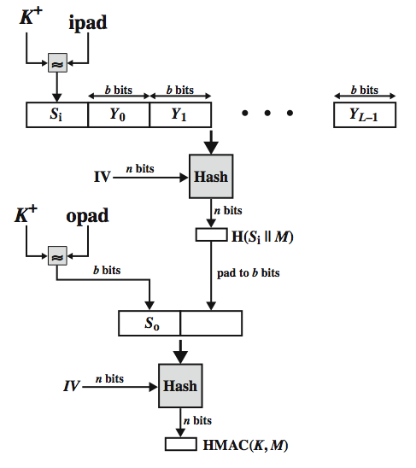
HMAC Overview
Notes:
Stallings Figure 12.5 illustrates the overall operation of HMAC:
HMAC_{K} = Hash[(K⁺ XOR opad) || Hash[(K⁺ XOR ipad) || M)]
where:
K⁺ is K padded with zeros on the left so that the result is b bits in length
ipad is a pad value of 36 hex repeated to fill block
opad is a pad value of 5C hex repeated to fill block
M is the message input to HMAC (including the padding specified in the embedded hash function)
Note that the XOR with ipad results in flipping one-half of the bits of K. Similarly, the XOR with opad results in flipping one-half of the bits of K, but a different set of bits. In effect, pseudorandomly generated two keys from K. HMAC should execute in approximately the same time as the embedded hash function for long messages. HMAC adds three executions of the hash compression function (for Si, So, and the block produced from the inner hash). A more efficient implementation is possible by precomputing the internal hash function on (K⁺ XOR opad) and (K⁺ XOR ipad) and inserting the results into the hash processing at start & end. With this implementation, only one additional instance of the compression function is added to the processing normally produced by the hash function. This is especially worthwhile if most of the messages for which a MAC is computed are short.

Slide 20
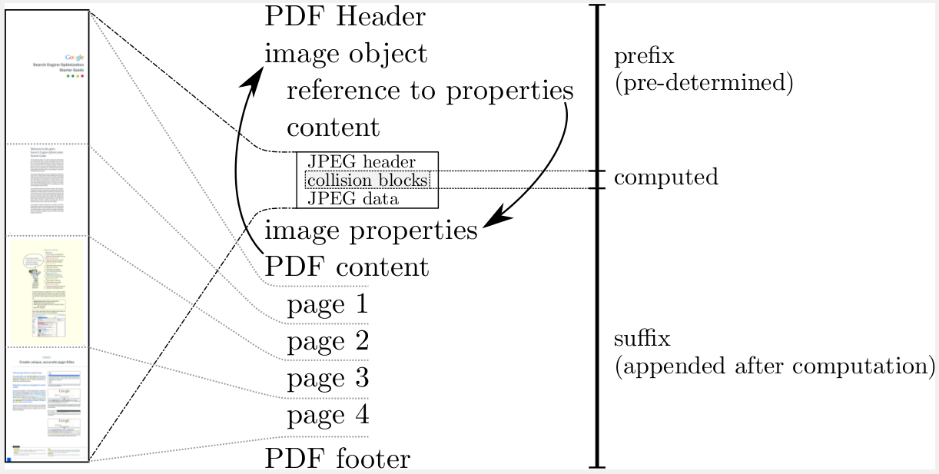
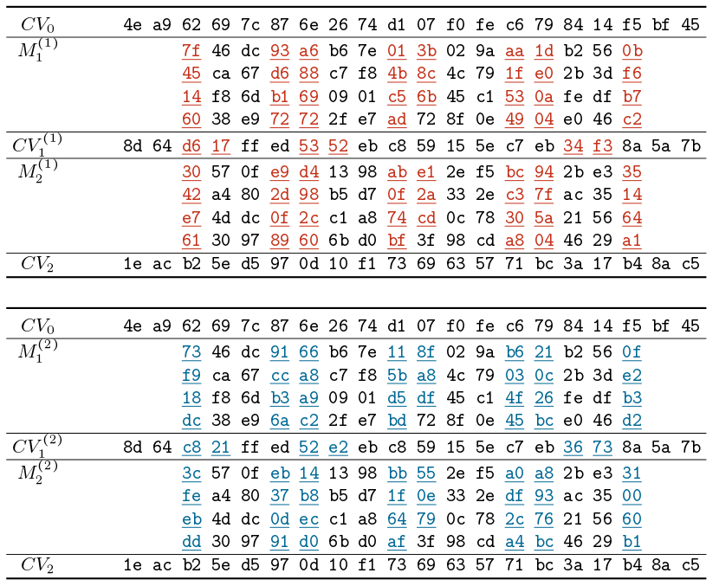
Case study: the SHAttered attack
“Universal” fixed strings for birthday attacks in SHA1 are known Tool: sha1-collider
SHA-1(P∣∣M₁⁽¹⁾∣∣M₂⁽¹⁾∣∣S)
= SHA-1 (P∣∣M₁⁽²⁾∣∣M₂⁽²⁾∣∣S)

Slide 21
Issue
The above schemes are ok, but what if Bob itself wants to impersonate Alice? This is possible because K is known to two parties
What if we could have something where K is known to just one party? → public key cryptography

Slide 22

The DIFFIE-HELLMAN KEY EXCHANGE

Slide 23
Key exchange – A strategic problem
All of cryptography is based on the idea of a number of people sharing a secret value
Classically solved with sideband transmission (“pizzini”)
In the modern era, solved with magical key exchange protocols
Idea: can Alice & Bob agree on a secret value without shouting the secret value each other on the wire? YES!

Slide 24
Diffie-Hellman Key Exchange
First published public-key algorithm
A number of commercial products employ this key exchange technique (TLS among others)
Purpose is to enable two users to securely exchange a key that can then be used for subsequent symmetric encryption of messages
The algorithm itself is limited to the exchange of secret values
Its effectiveness depends on the difficulty of computing discrete logarithms
Notes:
The first published public-key algorithm appeared in the seminal paper by Diffie and Hellman that defined public-key cryptography [DIFF76b] and is generally referred to as Diffie-Hellman key exchange. A number of commercial products employ this key exchange technique.
The purpose of the algorithm is to enable two users to securely exchange a key that can then be used for subsequent symmetric encryption of messages. The algorithm itself is limited to the exchange of secret values.
The Diffie-Hellman algorithm depends for its effectiveness on the difficulty of computing discrete logarithms. Briefly, we can define the discrete logarithm in the following way. Recall from Chapter 2 that a primitive root of a prime number p is one whose powers modulo p generate all the integers from 1 to p - 1. That is, if a
is a primitive root of the prime number p, then the numbers
a mod p , a² mod p , . . . , a^{p-1} mod p
are distinct and consist of the integers from 1 through p - 1 in some permutation.
For any integer b and a primitive root a of prime number p , we can find a unique exponent i such that
b = a^{i} (mod p ) where 0 ≤ i ≤ (p - 1)
The exponent i is referred to as the discrete logarithm of b for the base a , mod p . We express this value as dlog_{a,p} (b ). See Chapter 2 for an extended discussion of discrete logarithms.

Slide 25
K_{AB} = a^{xA.xB} mod q
Notes:
Figure 10.1 summarizes the Diffie-Hellman key exchange algorithm. For this scheme, there are two publicly known numbers: a prime number q and an integer a that is a primitive root of q .
Figure 10.1 shows a simple protocol that makes use of the Diffie–Hellman calculation. Suppose that user A wishes to set up a connection with user B and use a secret key to encrypt messages on that connection. User A can generate a one-time private key X_{A}, calculate Y_{A}, and send that to user B. User B responds by generating a private value X_{B}, calculating Y_{B}, and sending Y_{B} to user A. Both users can now calculate the key. The necessary public values q and a would need to be known ahead of time. Alternatively, user A could pick values for q and a and include those in the first message.

Slide 26
Notes:
The protocol depicted in Figure 10.1 is insecure against a man-in-the-middle attack. Suppose Alice and Bob wish to exchange keys, and Darth is the adversary. The attack proceeds as follows (Figure 10.2).
Darth prepares for the attack by generating two random private keys X_{D1} and X_{D2} and then computing the corresponding public keys Y_{D1} and Y_{D2}
Alice transmits Y_{A} to Bob.
Darth intercepts Y_{A} and transmits Y_{D1} to Bob. Darth also calculates K2 = (Y_{A} )^ X_{D2} mod q
Bob receives Y_{D1} and calculates K1=(Y_{D1} )^ X_{B} mod q
Bob transmits Y_{B} to Alice.
Darth intercepts Y_{B} and transmits Y_{D2} to Alice. Darth calculates K1=(Y_{B} )^ X_{D1} mod q
Alice receives Y_{D2} and calculates K2=(Y_{D2} )^ X_{A} mod q .
At this point, Bob and Alice think that they share a secret key, but instead Bob and Darth share secret key K1 and Alice and Darth share secret key K2. All future communication between Bob and Alice is compromised in the following way:
Alice sends an encrypted message M: E(K2, M).
Darth intercepts the encrypted message and decrypts it, to recover M.
Darth sends Bob E(K1, M) or E(K1, M'), where M' is any message. In the first case, Darth simply wants to eavesdrop on the communication without altering it. In the second case, Darth wants to modify the message going to Bob.
The key exchange protocol is vulnerable to such an attack because it does not authenticate the participants. This vulnerability can be overcome with the use of digital signatures and public-key certificates.

Slide 27
Diffie-Hellman Setup
all users agree on global parameters:
large prime integer q
a being a primitive root mod q
each user (eg. A) generates their key
chooses a secret key (number): x_{A} < q
compute their public key: y_{A} = a^{xA} mod q
each user makes public that key y_{A}
Notes:
In the Diffie-Hellman key exchange algorithm, there are two publicly known numbers: a prime number q and an integer a that is a primitive root of q. The prime q and primitive root a can be common to all using some instance of the D-H scheme. Note that the primitive root a is a number whose powers successively generate all the elements mod q. Users Alice and Bob choose random secrets x's, and then "protect" them using exponentiation to create their public y's. For an attacker monitoring the exchange of the y's to recover either of the x's, they'd need to solve the discrete logarithm problem, which is hard.

Slide 28
Diffie-Hellman Key Exchange
shared session key for users A & B is K_{AB}:
K_{AB} = a^{xA.xB} mod q
= y_{A}^{xB} mod q (which B can compute)
= y_{B}^{xA} mod q (which A can compute)
K_{AB} is used as session key in private-key encryption scheme between Alice and Bob
if Alice and Bob subsequently communicate, they will have the same key as before, unless they choose new public-keys
attacker needs an x, must solve discrete log
Notes:
The actual key exchange for either party consists of raising the others "public key' to power of their private key. The resulting number (or as much of as is necessary) is used as the key for a block cipher or other private key scheme. For an attacker to obtain the same value they need at least one of the secret numbers, which means solving a discrete log, which is computationally infeasible given large enough numbers. Note that if Alice and Bob subsequently communicate, they will have the same key as before, unless they choose new public-keys.

Slide 29
Diffie-Hellman Example
users Alice & Bob who wish to swap keys:
agree on prime q=353 and a=3
select random secret keys:
A chooses x_{A}=97, B chooses x_{B}=233
compute respective public keys:
y_{A}=3⁹⁷ mod 353 = 40 (Alice)
y_{B}=3²³³ mod 353 = 248 (Bob)
compute shared session key as:
K_{AB}= y_{B}^{xA} mod 353 = 248⁹⁷ = 160 (Alice)
K_{AB}= y_{A}^{xB} mod 353 = 40²³³ = 160 (Bob)
Notes:
Here is an example of Diffie-Hellman from the text using prime q=353, showing how each computes its public key, and then how after they exchange public keys, each can compute the common secret key.I n this simple example, it would be possible by brute force to determine the secret key 160. In particular, an attacker E can determine the common key by discovering a solution to the equation 3ª mod 353 = 40 or the equation 3^{b} mod 353 = 248. The brute-force approach is to calculate powers of 3 modulo 353, stopping when the result equals either 40 or 248. The desired answer is reached with the exponent value of 97, which provides 3⁹⁷ mod 353 = 40. With larger numbers, the problem becomes impractical.

Slide 30
Man-in-the-Middle Attack
Darth prepares by creating two private / public keys
Alice transmits her public key to Bob
Darth intercepts this and transmits his first public key to Bob. Darth also calculates a shared key with Alice
Bob receives the public key and calculates the shared key (with Darth instead of Alice)
Bob transmits his public key to Alice
Darth intercepts this and transmits his second public key to Alice. Darth calculates a shared key with Bob
Alice receives the key and calculates the shared key (with Darth instead of Bob)
Darth can then intercept, decrypt, re-encrypt, forward all messages between Alice & Bob
Notes:
The protocol described on the previous slide is insecure against a man-in-the-middle attack. Suppose Alice and Bob wish to exchange keys, and Darth is the adversary. The attack proceeds as follows:
Darth prepares for the attack by generating two random private keys X_{D1} and X_{D2} and then computing the corresponding public keys Y_{D1} and Y_{D2}
Alice transmits Y_{A} to Bob.
Darth intercepts Y_{A} and transmits Y_{D1} to Bob. Darth also calculates K2 = (Y_{A} )^ X_{D2} mod q
Bob receives Y_{D1} and calculates K1=(Y_{D1} )^ X_{B} mod q
Bob transmits Y_{B} to Alice.
Darth intercepts Y_{B} and transmits Y_{D2} to Alice. Darth calculates K1=(Y_{B} )^ X_{D1} mod q
Alice receives Y_{D2} and calculates K2=(Y_{D2} )^ X_{A} mod q .
At this point, Bob and Alice think that they share a secret key, but instead Bob and Darth share secret key K1 and Alice and Darth share secret key K2. All future communication between Bob and Alice is compromised in the following way:
Alice sends an encrypted message M: E(K2, M).
Darth intercepts the encrypted message and decrypts it, to recover M.
Darth sends Bob E(K1, M) or E(K1, M'), where M' is any message. In the first case, Darth simply wants to eavesdrop on the communication without altering it. In the second case, Darth wants to modify the message going to Bob. The key exchange protocol is vulnerable to such an attack because it does not authenticate the participants. This vulnerability can be overcome with the use of digital signatures and public- key certificates.

Slide 31
General public key cryptography

Slide 32
The limits of classic cryptography
Key exchange
Integrity
Authenticity
Non-repudiation

Slide 33
Public-Key Cryptosystems
A public-key encryption scheme has six ingredients:
Plaintext
The readable message or data that is fed into the algorithm as input
Encryption algorithm
Performs various transforma-tions on the plaintext
Public key
Used for encryption or decryption
Private key
Used for encryption or decryption
Ciphertext
The scrambled message produced as output
Decryption algorithm
Accepts the ciphertext and the matching key and produces the original plaintext
Notes:
Asymmetric algorithms rely on one key for encryption and a different but related
key for decryption. These algorithms have the following important characteristic.
• It is computationally infeasible to determine the decryption key given only
knowledge of the cryptographic algorithm and the encryption key.
In addition, some algorithms, such as RSA, also exhibit the following characteristic.
• Either of the two related keys can be used for encryption, with the other used
for decryption.
A public-key encryption scheme has six ingredients (Figure 9.1a; compare
with Figure 3.1).
• Plaintext: This is the readable message or data that is fed into the algorithm as
input.
• Encryption algorithm: The encryption algorithm performs various transformations
on the plaintext.
• Public and private keys: This is a pair of keys that have been selected so that
if one is used for encryption, the other is used for decryption. The exact transformations
performed by the algorithm depend on the public or private key
that is provided as input.
• Ciphertext: This is the scrambled message produced as output. It depends on
the plaintext and the key. For a given message, two different keys will produce
two different ciphertexts.
• Decryption algorithm: This algorithm accepts the ciphertext and the matching
key and produces the original plaintext.

Slide 34
Public-Key Cryptosystem: Confidentiality
Notes:
Let us take a closer look at the essential elements of a public-key encryption
scheme, using Figure 9.2 (compare with Figure 3.2).
The scheme illustrated in Figure 9.2 provides confidentiality.

Slide 35
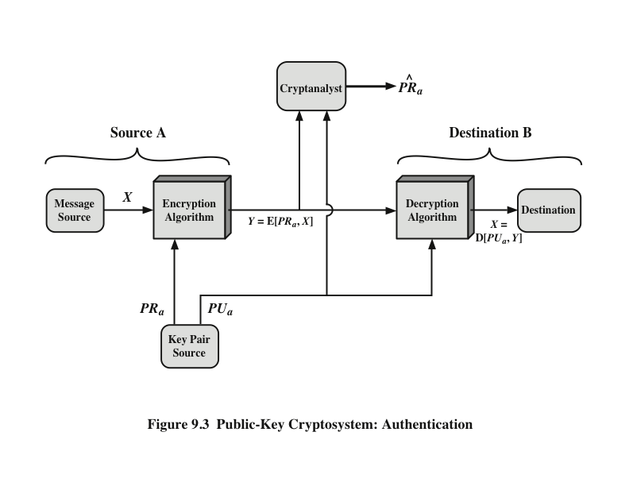
Public-Key Cryptosystem: Authentication
Notes:
We mentioned earlier that either of the two related keys can be used for encryption,
with the other being used for decryption. This enables a rather different
cryptographic scheme to be implemented. Whereas the scheme illustrated in
Figure 9.2 provides confidentiality, Figures 9.1b and 9.3 show the use of public-key
encryption to provide authentication.
It is important to emphasize that the encryption process depicted in
Figures 9.1b and 9.3 does not provide confidentiality. That is, the message being
sent is safe from alteration but not from eavesdropping. This is obvious in the
case of a signature based on a portion of the message, because the rest of the
message is transmitted in the clear. Even in the case of complete encryption,
as shown in Figure 9.3, there is no protection of confidentiality because any
observer can decrypt the message by using the sender’s public key.

Slide 36
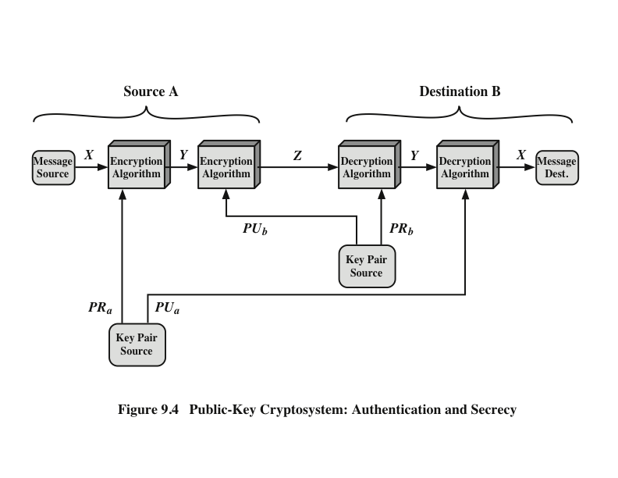
Public-Key Cryptosystem: Authentication and Secrecy
Notes:
It is, however, possible to provide both the authentication function and confidentiality
by a double use of the public-key scheme (Figure 9.4).
In this case, we begin as before by encrypting a message, using the sender’s private
key. This provides the digital signature. Next, we encrypt again, using the receiver’s
public key. The final ciphertext can be decrypted only by the intended receiver, who
alone has the matching private key. Thus, confidentiality is provided. The disadvantage
of this approach is that the public-key algorithm, which is complex, must be
exercised four times rather than two in each communication.

Slide 37
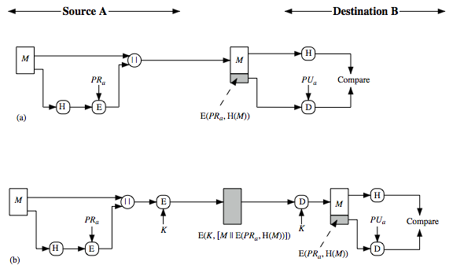
Hash Functions & Digital Signatures
Notes:
Another important application, which is similar to the message authentication application, is the digital signature. The operation of the digital signature is similar to that of the MAC. In the case of the digital signature, the hash value of a message is encrypted with a user's private key. Anyone who knows the user's public key can verify the integrity of the message that is associated with the digital signature. In this case an attacker who wishes to alter the message would need to know the user's private key. As we shall see in Chapter 14, the implications of digital signatures go beyond just message authentication. Stallings Figure 11.3 illustrates, in a simplified fashion, how a hash code is used to provide a digital signature:
The hash code is encrypted, using public-key encryption and using the sender's private key. As with Figure 11.2b, this provides authentication. It also provides a digital signature, because only the sender could have produced the encrypted hash code. In fact, this is the essence of the digital signature technique.
If confidentiality as well as a digital signature is desired, then the message plus the private-key-encrypted hash code can be encrypted using a symmetric secret key. This is a common technique.

Slide 38
Public-Key Requirements
Conditions that these algorithms must fulfill:
It is computationally easy for a party B to generate a pair (public-key PU_{b}, private key PR_{b})
It is computationally easy for a sender A, knowing the public key and the message to be encrypted, to generate the corresponding ciphertext
It is computationally easy for the receiver B to decrypt the resulting ciphertext using the private key to recover the original message
It is computationally infeasible for an adversary, knowing the public key, to determine the private key
It is computationally infeasible for an adversary, knowing the public key and a ciphertext, to recover the original message
The two keys can be applied in either order
Notes:
The cryptosystem illustrated in Figures 9.2 through 9.4 depends on a cryptographic algorithm based on two related keys. Diffie and Hellman postulated this system without demonstrating that such algorithms exist. However, they did lay out the conditions that such algorithms must fulfill: [DIFF76b].
It is computationally easy for a party B to generate a pair (public key PU_{b}, private key PR_{b}).
It is computationally easy for a sender A, knowing the public key and the message to be encrypted, M, to generate the corresponding ciphertext:
C = E(PU_{b}, M)
3. It is computationally easy for the receiver B to decrypt the resulting ciphertext using the private key to recover the original message:
M = D(PR_{b}, C) = D[PR_{b}, E(PU_{b}, M)
4. It is computationally infeasible for an adversary, knowing the public key, PU_{b}, to determine the private key, PR_{b}
5. It is computationally infeasible for an adversary, knowing the public key, PU_{b}, and a ciphertext, C, to recover the original message, M.
6. The two keys can be applied in either order:
M = D[PU_{b} , E(PR_{b}, M)] = D[PR_{b}, E(PU_{b}, M)]
These are formidable requirements, as evidenced by the fact that only a few algorithms (RSA, elliptic curve cryptography, Diffie-Hellman, DSS) have received widespread acceptance in the several decades since the concept of public-key cryptography was proposed.

Slide 39
Public-Key Requirements
Need a trap-door one-way function
A one-way function is one that maps a domain into a range such that every function value has a unique inverse, with the condition that the calculation of the function is easy, whereas the calculation of the inverse is infeasible
Y = f(X) easy
X = f^{–1}(Y) infeasible
A trap-door one-way function is a family of invertible functions f_{k}, such that
Y = f_{k}(X) easy, if k and X are known
X = f_{k}^{–1}(Y) easy, if k and Y are known
X = f_{k}^{–1}(Y) infeasible, if Y known but k not known
A practical public-key scheme depends on a suitable trap-door one-way function
Notes:
Before elaborating on why the requirements are so formidable, let us first recast
them. The requirements boil down to the need for a trap-door one-way function.
A one-way function is one that maps a domain into a range such that every
function value has a unique inverse, with the condition that the calculation of the
function is easy, whereas the calculation of the inverse is infeasible
Y = f(X) easy
X = f^{–1}(Y) infeasible
Generally, easy is defined to mean a problem that can be solved in polynomial
time as a function of input length. Thus, if the length of the input is n bits, then the
time to compute the function is proportional to nª , where a is a fixed constant. Such
algorithms are said to belong to the class P . The term infeasible is a much fuzzier
concept. In general, we can say a problem is infeasible if the effort to solve it grows
faster than polynomial time as a function of input size. For example, if the length
of the input is n bits and the time to compute the function is proportional to 2^{n} ,
the problem is considered infeasible. Unfortunately, it is difficult to determine if a
particular algorithm exhibits this complexity. Furthermore, traditional notions of
computational complexity focus on the worst-case or average-case complexity of
an algorithm. These measures are inadequate for cryptography, which requires that
it be infeasible to invert a function for virtually all inputs, not for the worst case or
even average case. [LAI18] provides an excellent introduction to complexity.
We now turn to the definition of a trap-door one-way function , which is easy
to calculate in one direction and infeasible to calculate in the other direction unless
certain additional information is known. With the additional information the
inverse can be calculated in polynomial time. We can summarize as follows: A trapdoor
one-way function is a family of invertible functions f_{k} , such that
Y = f_{k}(X) easy, if k and X are known
X = f_{k}^{–1}(Y) easy, if k and Y are known
X = f_{k}^{–1}(Y) infeasible, if Y known but k not known
Thus, the development of a practical public-key scheme depends on discovery of a suitable trap-door one-way function.

Slide 40
Commonly used PK ciphers
RSA + DSS (prime number based)
Long keys difficult to generate, slow
Elgamal (discrete logarithms)
ECDSA (elliptic curves)
Shorter keys, faster

